Slide 1
Using Social Justice Themes in the ESL Classroom

Slide 2
Agenda: March 3, 2018
Social Justice and ESL: A Rationale
Classroom Peacebuilding
Educating Students about their Rights
Helping Students Advocate for Change
Using Historical Examples
Discussion

Slide 3
Using Social Justice Themes: A Rationale
“Every language curriculum requires content... The teaching of whole learners must be rooted in their reality… The kind of education that brackets off these sometimes troubling parts of learners’ lives may be the one that reproduces structures of inequality and oppresses people, disempowering them because it denies them the tools for addressing and possibly changing their reality.”
Language Teaching as a Peacebuilding Endeavor, Medley, 2016
Notes:
We might think this is our job or we’re not supposed to talk about certain issues. But you can’t teach langauge in a vacuum,you have to choose some content. And we should be choosing content that is meaningful for our students and addresses our students as whole people.

Slide 4
Classroom Peacebuilding
:
Emphasize perspectives
Teach Dialogue Skills
Engage students in interactive lessons using creativity
Share real stories
Leave students feeling empowered
- Peacebuilding in the English Language Classroom, (Jakar and Milofsky, 2016)
Notes:
These are things we already do,and by doing this we’re empowering students to advocate for themselves and helping them to empathize with each other

Slide 5
classroom peacebuilding
“Language teachers are responsible for creating an atmosphere of respect, creating a classroom that becomes a model of the world as a context for tolerance and the appreciation of diversity.”
(Brown, 2009)
Notes:
Strength of our program is our diversity.And students learn as much from each other as from me, not just about language but about compassion. Students with a lot of disadvantages,next to students with a lot of privledges, and it’s an important education for those students with more advantages to learn what life is like for others.

Slide 6
Teaching Students about their Rights
Notes:
Rights and how to stand up for these rights and what they can do if these rights are not being respected.

Slide 7
Teaching Students About their Rights
 | Before Reading | After Reading | Page
You should answer all the questions that the police ask you.
If the police say you are not being detained, you may leave.
If you open the door and invite the police in, the police are allowed to enter your home without a warrant.
If the police are searching a public place, they do not need a warrant.
If the police tell you to sign a document, you should do so.
You can contact the consulate from your native country to help you if you are arrested.
You can only see a contract from your attorney after you pay him or her.
A power of attorney agreement is an agreement that helps you get a lawyer.
If you are detained by immigration, your family members can contact you.
You can choose to give the police a card explaining your decision to remain silent.

Slide 8
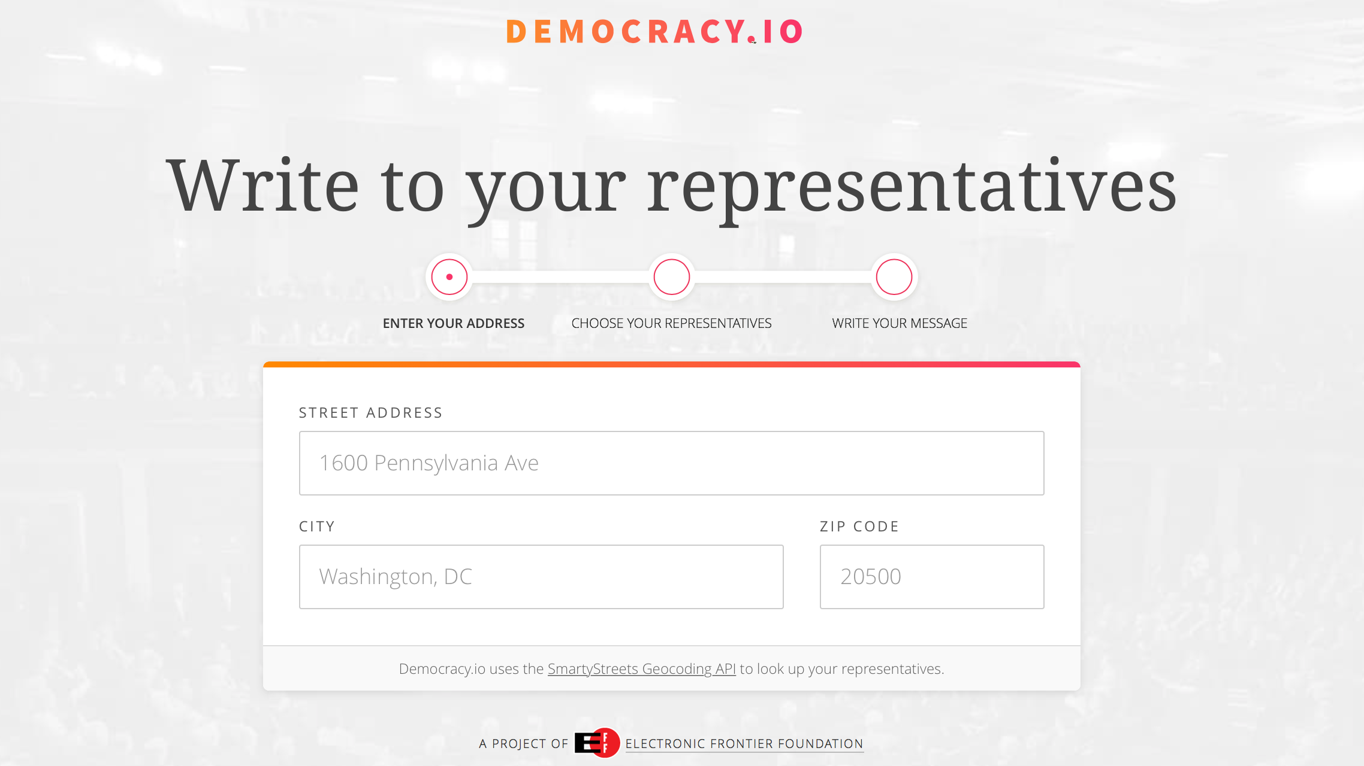
Teaching Students Advocacy Skills
Letter Writing:

Slide 9
Teaching Student Advocacy Skills
Call your representative:
(202) 224-3121

Slide 10
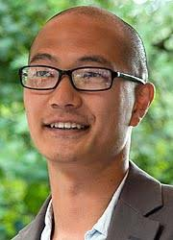
Teaching Student Advocacy Skills
Invite your Representative
State Delegate David Moon
Notes:
Looked at his voting record before.

Slide 11
Using Historical Examples of Social Justice Movements
Notes:
Louisiana- ruby bridges

Slide 12
Using Historical Examples Of Social Justice Movements
Extensive Reading:
Reading a biography of Dr. Martin Luther King as a class
Notes:
Extensive reading – took the whole class period

Slide 13
MLK Related Activities: Music

Slide 14
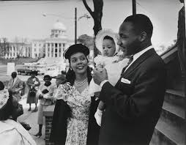
MLK Related Activities: Role Play
Notes:
Children’s Crusade: birmingham, Montgomery: bomb threat

Slide 15
MLK Related Activities: Debates

Slide 16
MLK Related Activities Movies/Documentaries

Slide 17
MLK Related Activities: Field Trips

Slide 18
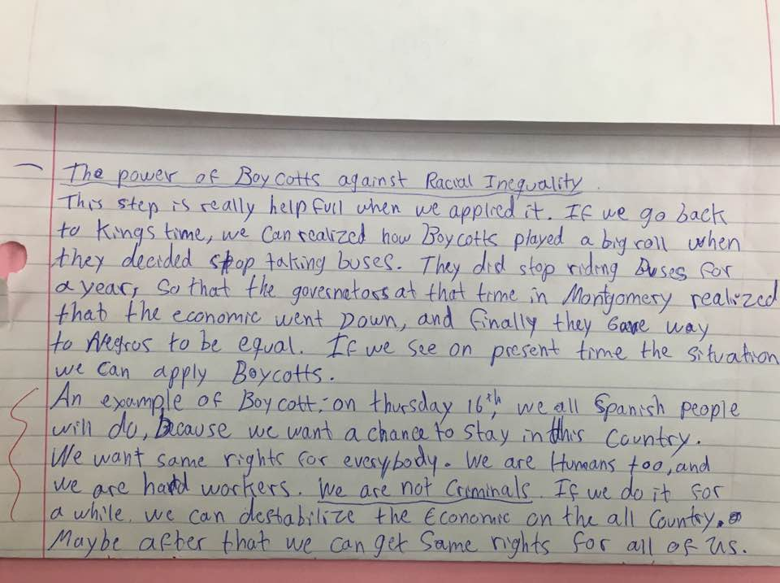
Cumulative Project: Relevance of MLK Today

Slide 19
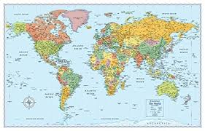
CUMULATIVE PROJECT: Compare mlk to someone from your country
Notes:
Learn critical thinking and about each other’s country

Slide 20
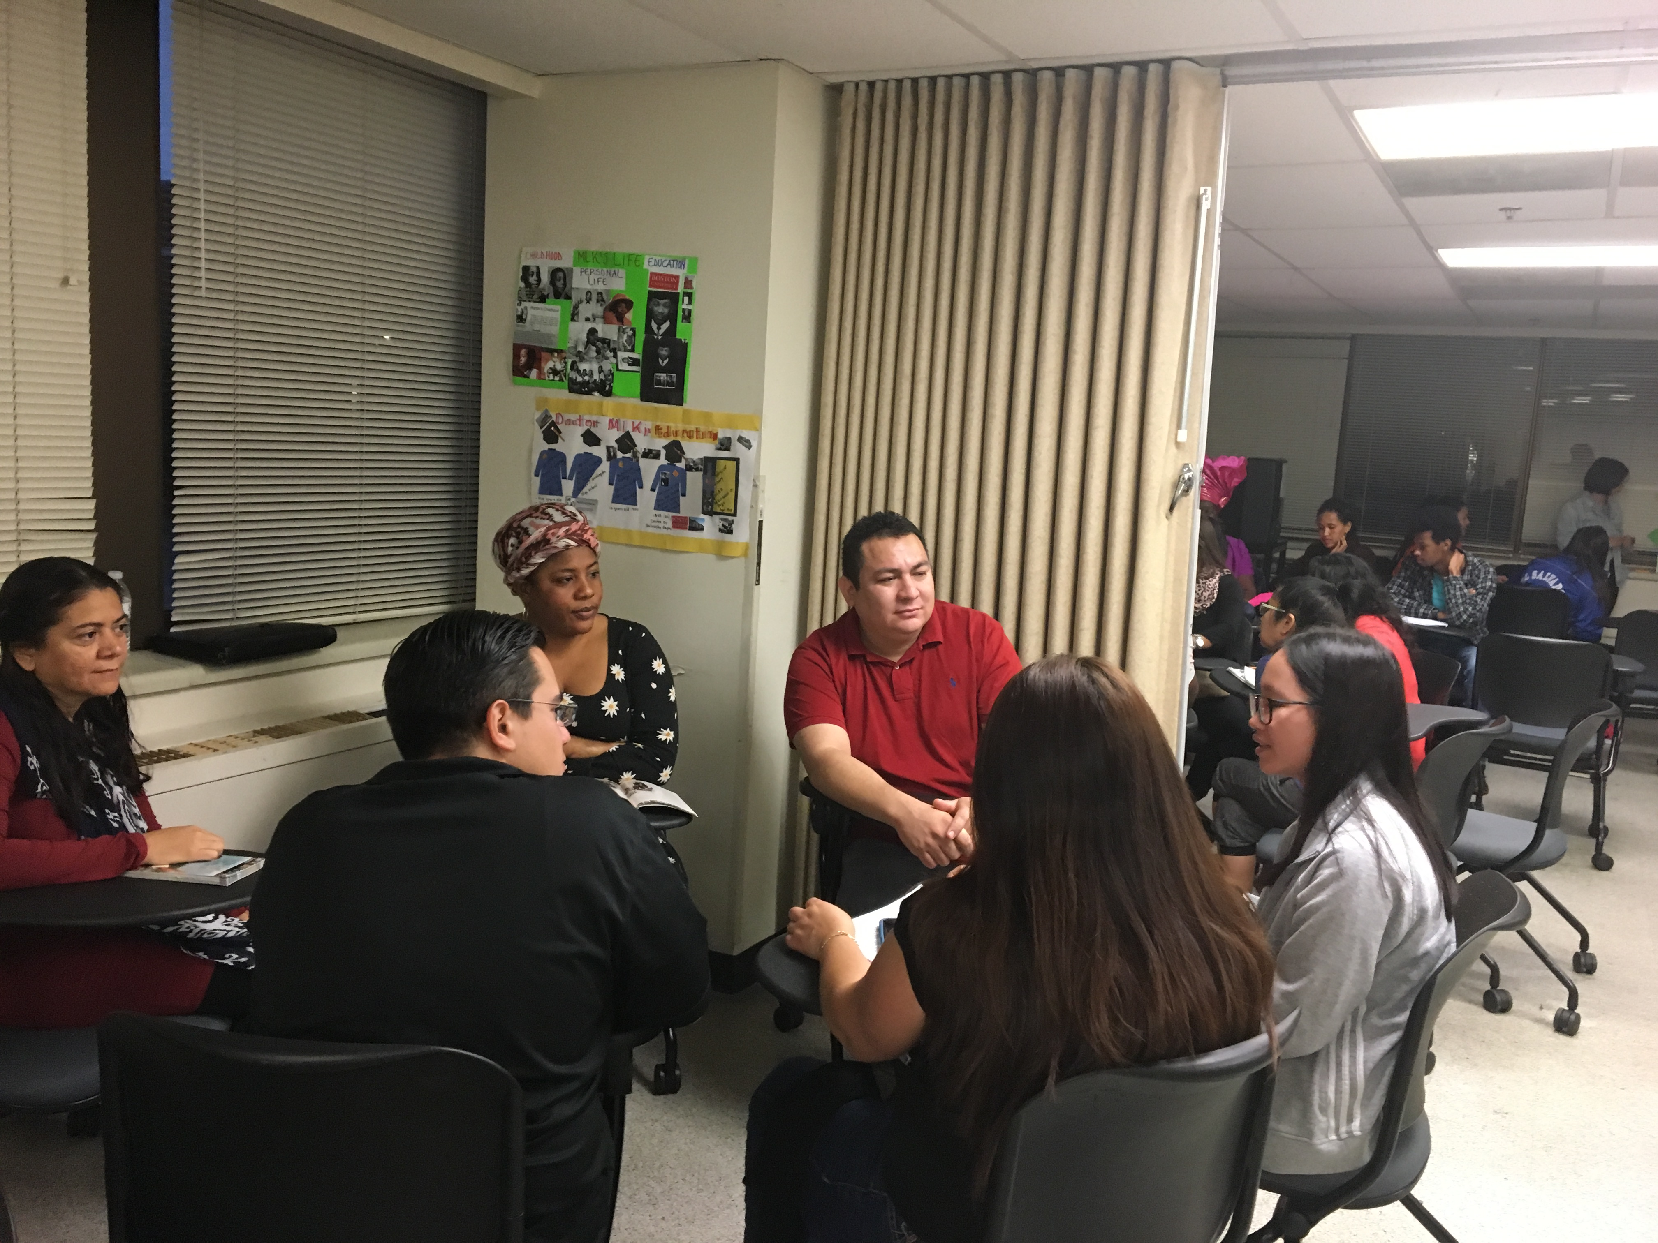
Cumulative project: Share what you’ve learned
Notes:
Different groups talk about a different aspects of his life and share with other classes

Slide 21
discuss
How have you incorporated social justice themes in your teaching?
What ideas do you have to incorporate social justice themes?

